Slide 1

C.L.U.E.
A System for Evaluating Citizenship
C.L.U.E. stands for Citizenship Law Understanding and Evaluation. This system aims to recognize and reward individuals who actively contribute to a stronger society.

Slide 2


Promoting Moral Duties
Respect for Laws
Community Engagement
Individuals are encouraged to follow traffic regulations, adhere to medical protocols, and maintain ethical conduct in corporate settings. This creates a safer and more trustworthy environment.
C.L.U.E. motivates individuals to contribute to community initiatives, volunteer their time, and participate in local events, fostering a sense of shared responsibility.
Environmental Stewardship
Charitable Giving
Encouraging individuals to donate to charities, participate in fundraising events, and offer support to those in need.
Promoting responsible environmental practices such as recycling, reducing waste, and conserving natural resources. This demonstrates care for the planet and the future.

Slide 3
Comprehensive Evaluation Criteria
Traffic
Medical
Corporate
Adhering to traffic laws, driving safely, and being courteous to other drivers.
Following medical guidelines, making informed healthcare decisions, and promoting preventative measures.
Acting ethically in business dealings, maintaining honesty and integrity, and contributing to responsible corporate practices.

Slide 4





Point System: Quantifying Good Citizenship
Points for Actions
C.L.U.E. awards points based on positive actions. For example, volunteering at a local food bank or donating blood could earn points.
Recognition and Rewards
Accumulated points can be used to redeem rewards, such as discounts on local services, priority access to events, or public recognition for outstanding citizenship.
Transparency and Fairness
A transparent system ensures fair and consistent point allocation. Individuals can track their points and understand how their actions contribute to a better society.

Slide 5




Incentivizing Positive Behavior
Motivation
The point system motivates individuals to engage in positive actions, knowing their contributions will be recognized and rewarded. It creates a sense of accomplishment and pride in making a difference.
Positive Reinforcement
C.L.U.E. provides a positive reinforcement mechanism that encourages individuals to continue participating in activities that benefit their community.
Social Impact
By incentivizing positive behavior, the system promotes a culture of civic engagement, leading to a more responsible and caring society.

Slide 6
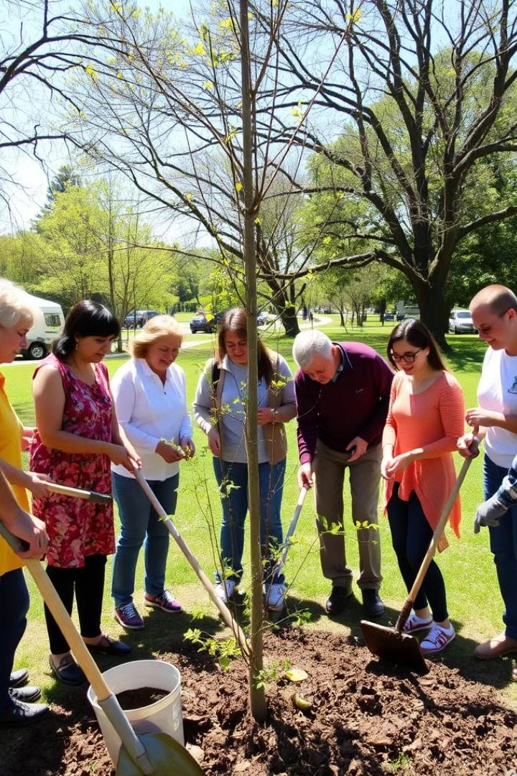
Encouraging Community Involvement
1
Local Initiatives
2
Volunteerism
C.L.U.E. promotes participation in local events, fundraisers, and community improvement projects, strengthening community bonds and fostering a sense of belonging.
Individuals are encouraged to volunteer their time and skills at organizations that align with their interests, creating a ripple effect of positive change.
3
Citizen Engagement
By encouraging active participation, C.L.U.E. empowers individuals to become involved in shaping their communities and contributing to their growth.

Slide 7


Strengthening Social Responsibility
C.L.U.E
Social Responsibility
Point system
Increased awareness of individual impact
Rewards
Positive reinforcement for ethical behavior
Community engagement
Strengthened bonds and a sense of shared purpose

Slide 8
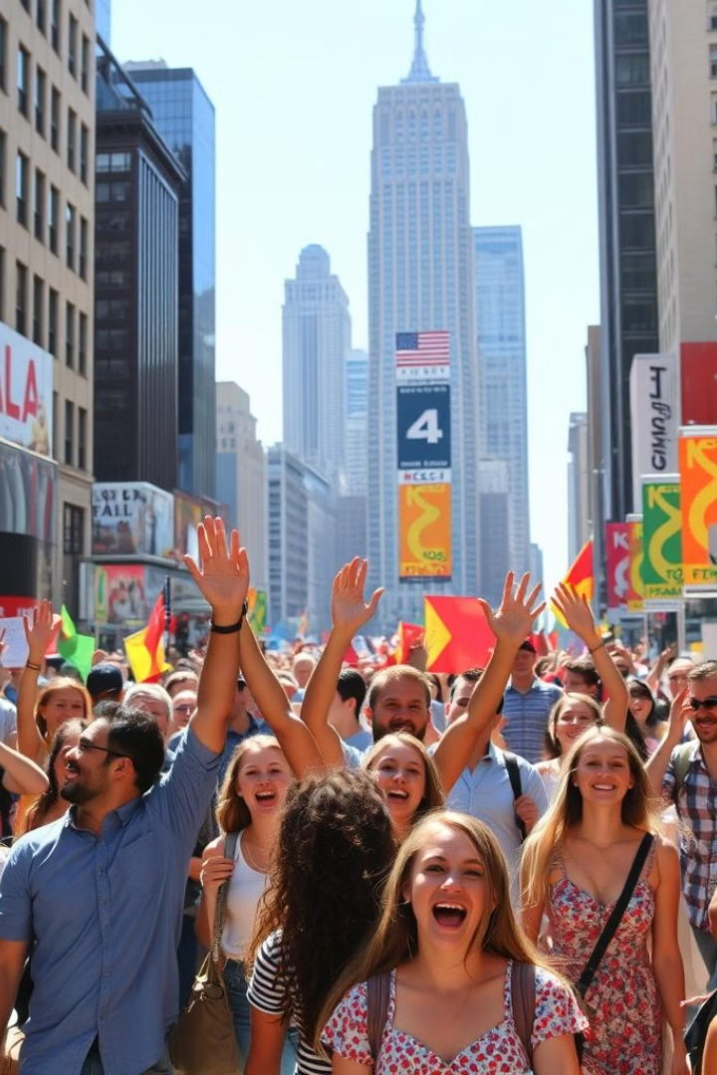
Fostering a Better Society
C.L.U.E. creates a system where everyone is encouraged to contribute, promoting a sense of shared responsibility and fostering a society where everyone can thrive.

